Slide 1
Java project ☺
Summer II 2019
Mario Velasquez

Slide 2
Project idea
- A database GUI program made in java to show the results of randomly generated integers within a matrix. Then solving for the determinant of said matrix. The GUI being a tool for mathematical tinkering and displaying useful statistical data.

Slide 3
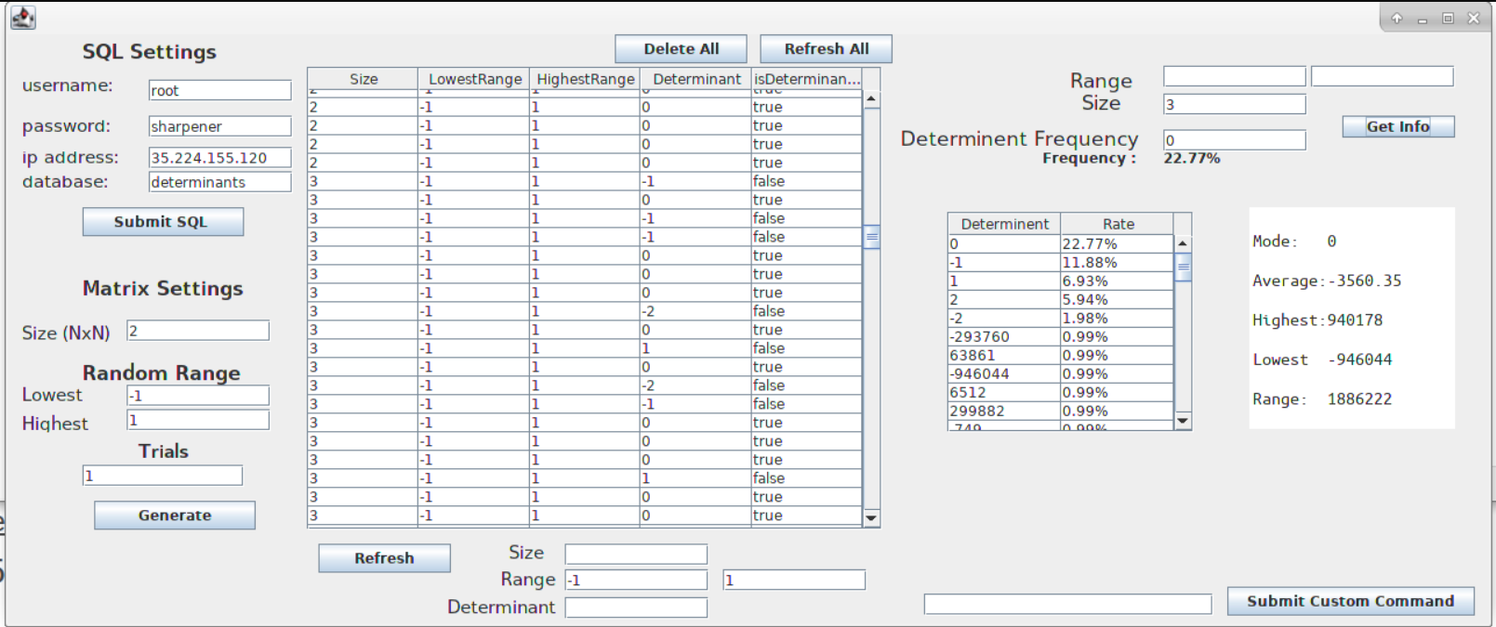
Quick preview

Slide 4
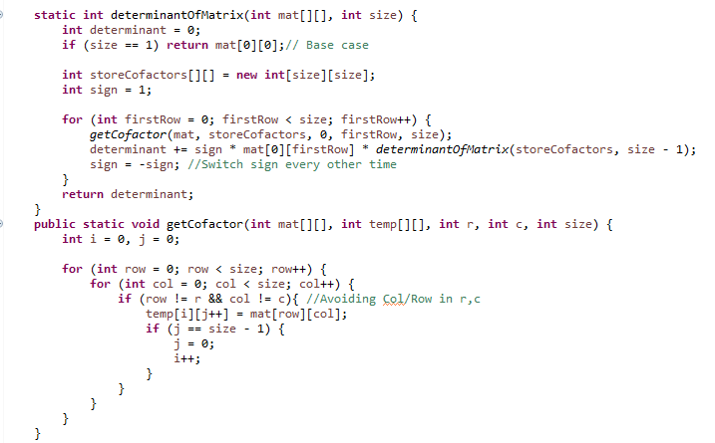
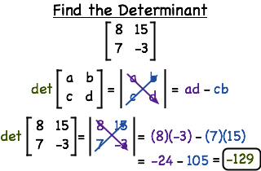
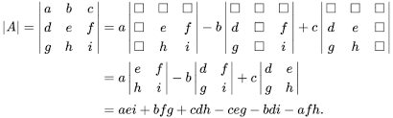
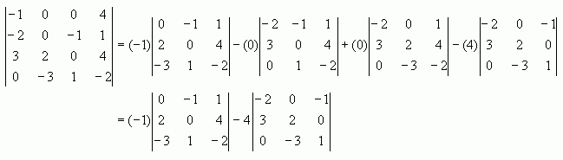
Math recap
CoFactoring method
- Recursive in Nature

Slide 5
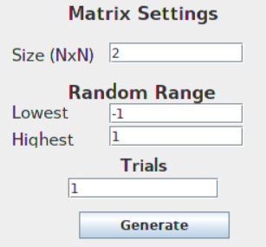





Matrix Settings – random range
Size (NxN) - Corresponds to the Length and Height , a uniform 2d Array.
Random Range – Lowest being the lowest possible range value and Highest being the highest possible range value.

Slide 6
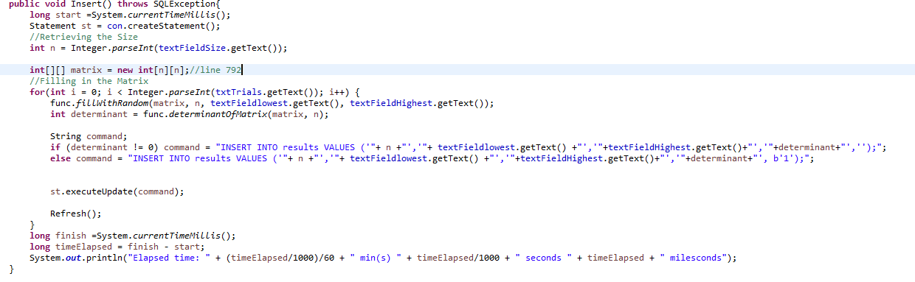






Inserting into the database
Create an Array with Input Size
Fill with Random Numbers
Trials is how many times this will repeat (each with unique random numbers)

Slide 7
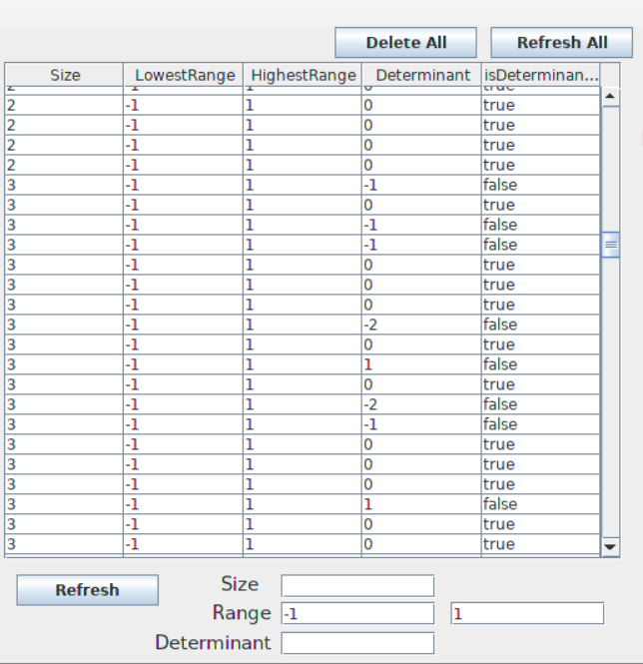


Viewing the table
Delete All – Deletes the entire Table
Refresh All – Refreshes Everything
Refresh – Refreshes based of !

Slide 8

Gui Tool main usage
Default to ‘0’
Default Determinant being searched is 0
One can change which determinant to be looked for
A determinant of zero means the matrix is not invertible
Called a singular Matrix
To compare the different set of ranges and its effect
To compare these differences across size
To see what variables have the most impact
Customize these variables with your !

Slide 9
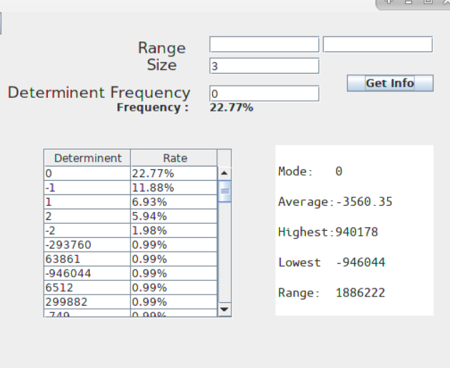
info
Approach:
Get Text Fields information,
Create a 2D-Array of the desired Results
Retrieve information out of each column with common low level algorithm’s.

Slide 10
Thank you!

